Slide 1
Pulmonary Embolism
BY: MOLLY and MICHAEL

Slide 2
Outline
Vocabulary
Background
Symptoms
Treatment
Conclusion
Works Cited

Slide 3
Vocabulary
Pulmonary Embolism : sudden blockage of a major blood vessel in the lung
Blood Clot: a gelatinous or semisolid mass of coagulated blood
Palpitations: a rapid, strong, or irregular heartbeat due to agitation, exertion, or illness.
Deep vein thrombosis: having a blood clot in a deep vein (like in the leg)
Anticoagulants: help prevent new blood clots and keep existing clots from forming
Thrombolytics: medicines that quickly dissolve blood clots

Slide 4
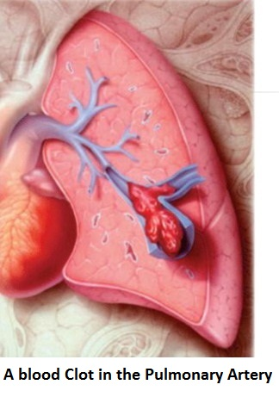
Background
A pulmonary embolism is the sudden blockage of a major blood vessel in the lung, usually caused by a blood clot.
They usually are not big clots an only cause some damage, but if the clot is big and causes blood flow to stop, it can be deadly.
Usually cased by deep vein thrombosis ( when a blood clot from a deep vein moves into the lung, usually from the leg).

Slide 5
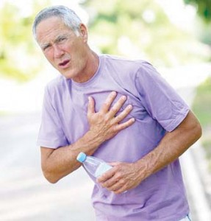
Symptoms
Sudden Shortness of breath
Sharp chest pain that is worse when you breathe
A cough that brings up pink, foamy mucus

Slide 6
Treatment
Anticoagulant medicines are given to prevent future blood clots from forming
Thrombolytic medicines are given to break up or dissolve large blood clots, if they are preventing blood flow.
If the blood clot is deadly, they can remove the blood clot with an embolectomy.
To prevent more blood clots from forming and traveling to the lungs people can wear compression stockings and increase their physical activity.

Slide 7
Conclusion
A pulmonary embolism is when one or more arteries in the lungs become blocked by a blood clot. This is usually caused by a blood clot traveling to the lungs from the legs. Pulmonary embolisms can be easily treated with medicine or surgery, and can be easily prevented with blood thinners, compression stockings, and physical activity.

Slide 8
Works Cited
Dalen, J. E., & Alpert, J. S. (1975). Natural history of pulmonary embolism. Progress in cardiovascular diseases, 17(4), 259-270.
Silverstein, M. D., Heit, J. A., Mohr, D. N., Petterson, T. M., O'Fallon, W. M., & Melton, L. J. (1998). Trends in the incidence of deep vein thrombosis and pulmonary embolism: a 25-year population-based study. Archives of internal medicine, 158(6), 585-593.

